Slide 1
Chapter Three*
Decision Structures and Boolean Logic
*Based on Starting Out with Python by Tony Gaddis

Slide 2
Chapter 3 Decision Structures and Boolean Logic
The if Statement
The if-else Statement
Comparing Strings
Logical Operators
Boolean Variables
Nested Decision Structures and the if-elif-else Statement

Slide 3
The if Statement
The if statement is used to create a decision structure, which allows a program to have more than one path of execution. It causes one or more statements to execute only when a Boolean expression is true.
Control structure – logical design that controls the order a set of statements execute.
Sequence structure – a set of statements that execute in the order that they appear
name = input (‘What is your name? ‘)
age = int ( input (‘What is your age? ‘)
print (‘Name: ‘, name)
print (‘Age: ‘, age)

Slide 4
The if Statement
Sequence structure does not always work for all situations. There are times when certain parts of the program should only be executed under certain conditions.
Example: If employees work over 40 hours, they are paid overtime. The program should only execute the code to calculate the overtime pay if the employee worked overtime.

Slide 5
Decision Structures
Decision Structure – control structure for when a set of statements should be executed only under certain conditions (also known as selection structures)

Slide 6
Decision Structures
Single Alternative Structure – only one alternative path of execution. If the condition is true, the statements are executed, otherwise they are not

Slide 7
if Statement in Python
if condition:
statement
statement
statement
if clause begins with if followed by a condition
The condition is an expression that will be evaluated as true or false followed by a colon
The statements are a block that must be consistently indented
If the condition is true, the block is executed. Otherwise it is not executed.

Slide 8
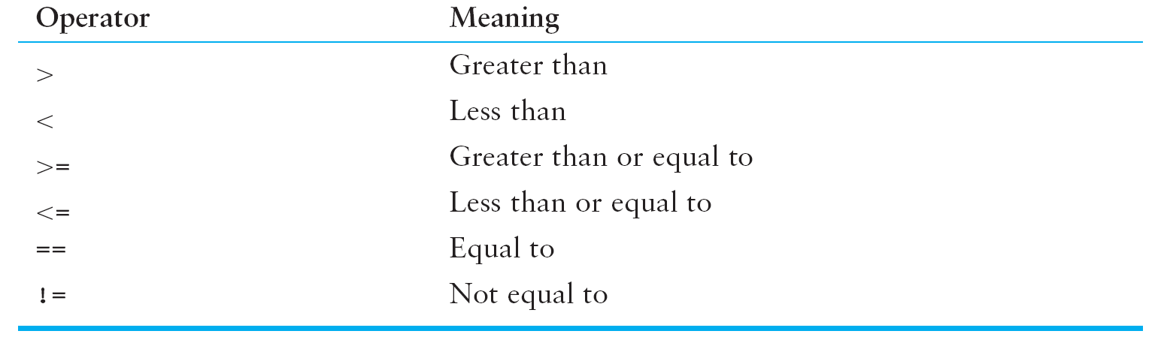
Boolean Expressions and Relational Operators
The expressions tested by the if statement are Boolean Expressions (named in honor of mathematician George Boole)
Typically they use Relational Operators which determine the relationship between two values

Slide 9
Boolean Expressions and Relational Operators
Note that == is the equality operator – not to be confused with the assignment operator =
The != is the not-equal-to operator. It is the opposite of the == operator
Demonstrate

Slide 10
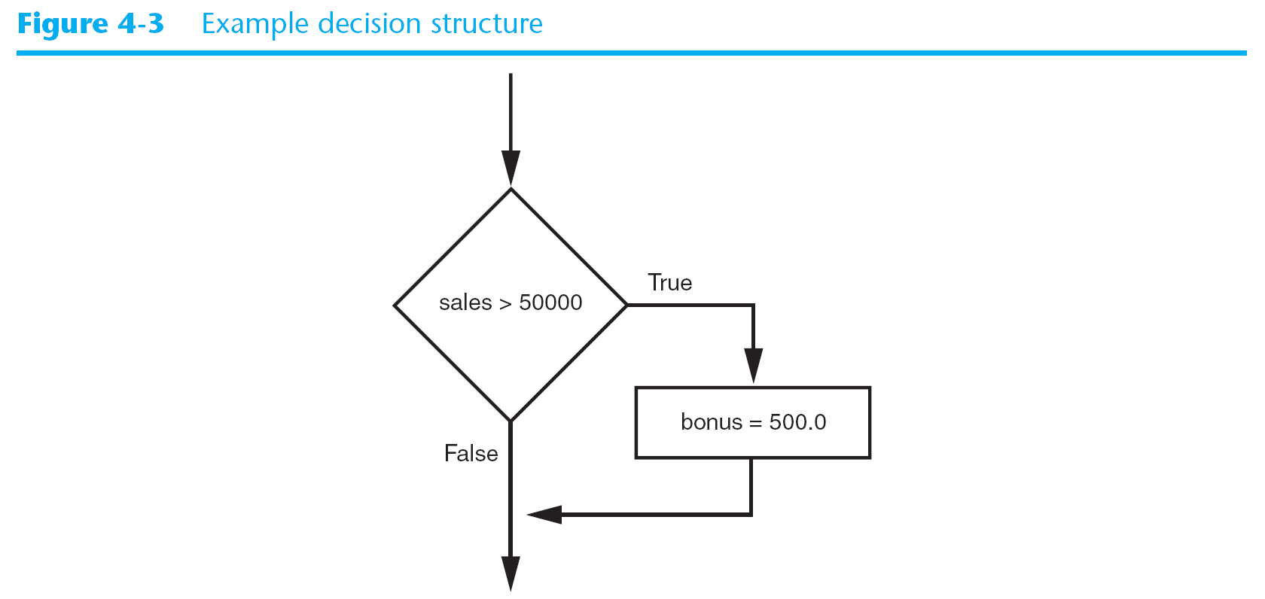
Putting Together if and Boolean Expressions
if sales > 50000:
bonus = 500.0

Slide 11
Putting Together if and Boolean Expressions
if sales > 50000:
bonus = 500.0
commission_rate = 0.12
print (‘You met your sales quota!’)

Slide 12
Using the if Statement
Kathryn teaches a science class and her students are required to take three tests. She wants to write program that her students can use to calculate their average test score. She also wants the program to congratulate the student if the average is greater than 95.
The pseudocode:
Get the first test score
Get the second test score
Get the third test score
Calculate the average
Display the average
If the average if greater than 95
Congratulate the user
Open test_average.py

Slide 13
Checkpoint
What is a control structure?
What is a decision structure?
What is a single alternative decision structure?
What is a Boolean expression?
What types of relationships can you test with relational operators?
Write an if statement that assigns 0 to x if y is equal to 20.
Write an if statement that assigns 0.2 to commissionRate if sales is greater than or equal to 10000.

Slide 14
The if-else Statement
An if-else statement will execute one block of statements if its condition is true or another block if the condition is false.
The dual alternative decision structure has two possible paths of execution, one if the condition is true and the second if the condition is false

Slide 15
if condition:
statement
statement
statement else: statement statement statement The condition is tested. If true, the statements following the if clause are executed otherwise the statements following the else are executed.
The if-else Statement

Slide 16
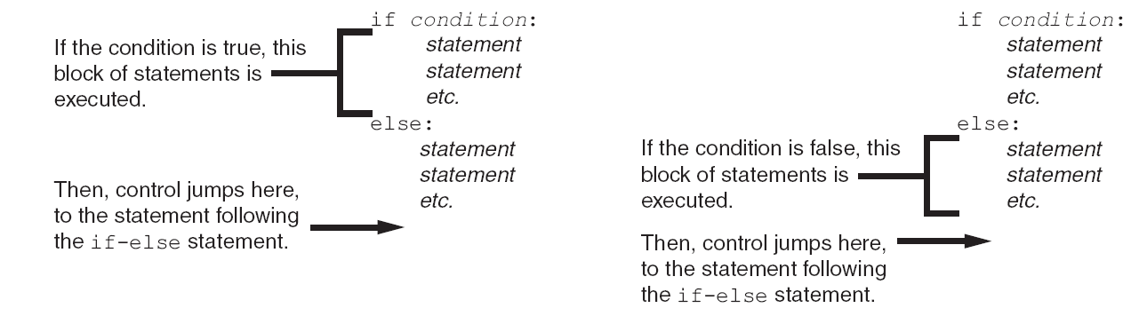
The if-else Statement

Slide 17
Indentation with If-Else
Make sure the if and else are aligned
Make sure the blocks following each are indented consistently

Slide 18
Using the if-else Statement
Chris owns an auto-repair business and has several employees. If any employee works over 40 hours in a week he pays them 1.5 times their regular hourly pay rate for all hours over 40. Design a simple payroll program that calculates an employee’s gross pay, including any overtime wages.
Pseudocode:
Get the number of hours worked
Get the hourly pay rate
If the employee worked more than 40 hours:
Calculate and display the gross pay with overtime
Else
Calculate and display the gross pay as usual
See auto_repair_payroll.py

Slide 19
Comparing Strings
Strings can be compared in decision structures as well as numbers
name1 = ‘Mary’
name2 = ‘Mark’
if name1 == name2:
print (‘The names are the same.’)
else:
print(‘The names are not the same.’)
If month != ‘October’:
print (‘This is the wrong time for Octoberfest!’)

Slide 20
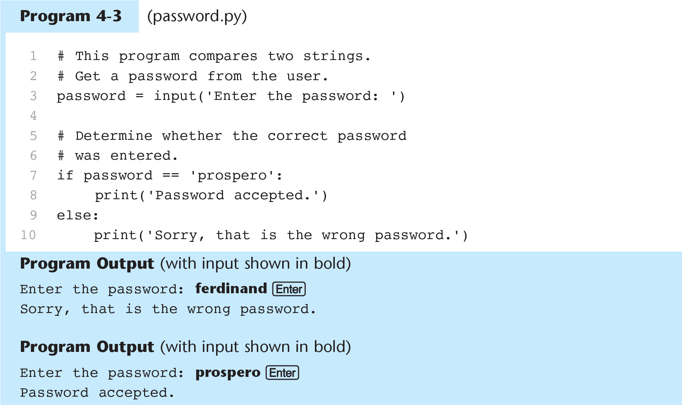
Comparing Strings

Slide 21
Other String Comparisons
You can also determine if one string is greater than or less than another. This is useful in sorting strings.
From Chapter 1, characters are stored as a numeric value:
Uppercase characters A – Z are the numbers 65 – 90
Lowercase characters a – z are 97 – 122
The digits 0 – 9 when stored as characters are 48 - 57
Blanks are the number 32
When characters are compared the numeric values are compared
If ‘a’ < ‘b’:
print (‘The letter a is less than the letter b’)

Slide 22
Comparing Strings

Slide 23
Comparing Strings
First the “M” in Mary and the “M” in Mark are compared. Since they are the same the next character is compared.
The remaining characters are compared one by one until a difference is found.
The one with the smaller value is considered the smaller string
If one string is shorter than the other, only the corresponding characters are compared. The shorter is considered to be smaller.

Slide 24
Comparing Strings
Open sort_names.py
What would the following display:
if 'z' < 'a':
print ('z is less than a')
else:
print ('z is not less than a')
city1 = 'New York'
city2 = 'Boston'
if city1 > city2:
print (city1)
print (city2)
else:
print (city2)
print (city1)

Slide 25
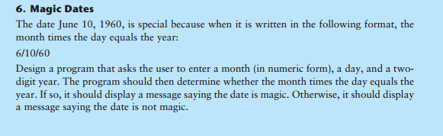
In Class Assignment Ch. 3 Part 1
Print and turn in source code when you are done.

Slide 26
3.5 Logical Operators
The logical operators : and, or, not
Allow you to connect Boolean expressions to make a compound expression

Slide 27
Logical Operators

Slide 28
The and Operator
Two Boolean expressions are combined into one compound Boolean expression which is true only if both subexpressions are true.
if temperature < 20 and minutes > 12:
print (‘The temperature is in the danger zone.’)

Slide 29
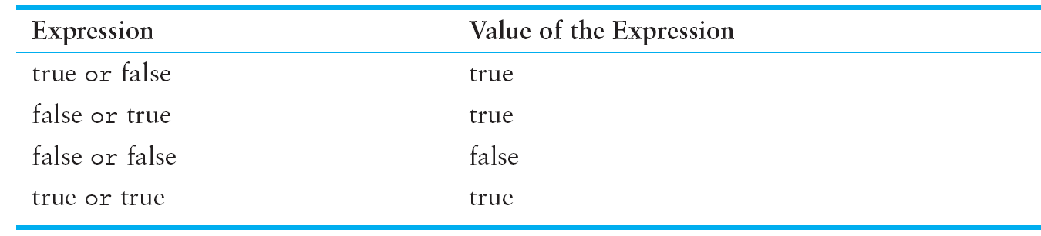
The or Operator
Two Boolean expressions are combined into one compound Boolean expression which is true if either subexpression is true.
if temperature < 20 or minutes > 12:
print (‘The temperature is in the danger zone.’)

Slide 30
The not Operator
The not operator takes the value of a Boolean expression and reverses the value of it.
If the expression is true, not makes it false. If the expression is false, not makes it true.
if not (temperature > 100):
print (‘This is below the maximum temperature.’)
Equivalent of asking “Is the temperature not greater than 100?”
not makes for confusing logic. Try to avoid it if possible.

Slide 31
Loan Qualifiers 2 & 3
Open loan_qualifier2.py and loan_qualifier3.py

Slide 32
Short-Circuit Evaluation
The and and or operators perform short-circuit evaluation.
For the and operator: If the left side of the expression is false, the right side will not be checked – the interpreter already knows the expression will be false and stops checking.
For the or operator: If the left side of the expression is true, the right side will not be checked – the interpreter already knows the expression will be true and stops checking.
This saves CPU time.

Slide 33
Checking Numeric Ranges with Logical Operators
Determining if a number is inside a range use and:
if x >= 20 and x <= 40:
print (‘The value is in the range.’)
Determining if a number is outside a range use or:
if x < 20 or x> 40:
print (‘The value is outside the range.’)

Slide 34
Boolean Variables
So far we have used three variable types: int, float, str
There is another type: bool which is for Boolean variables
A Boolean variable can reference one of two possible values: True or False
hungry == True
sleepy == False
These are commonly used as flags. A flag signals when some condition is true or false.
if sales >= 5000.0:
sales_quota_met = True
else:
sales_quota_met = False
The flag sales_quota_met indicates whether the sales quota has been met.
if sales_quota_met:
print (‘You have met your sales quota!’)

Slide 35
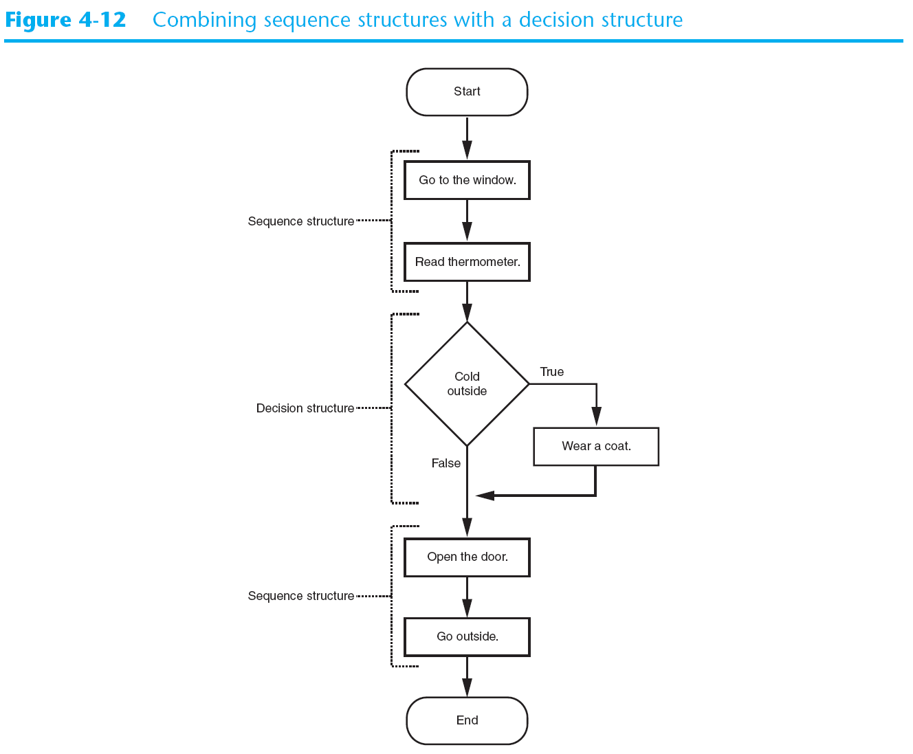
Nested Decision Structures and if-elif-else

Slide 36
Sequence Structure Nested in Decision Structure

Slide 37
Decision Structures Inside Other Decision Structures
To test more than one condition, a decision structure can be nested inside another decision structure
Example determine whether a bank customer qualifies for a loan:
Two conditions must exist:
The customer must earn at least $30,000 per year
The customer must have been employed for at least two years

Slide 38
Open loan qualifier.py

Slide 39
Proper Alignment of a Nested Decision Structure

Slide 40
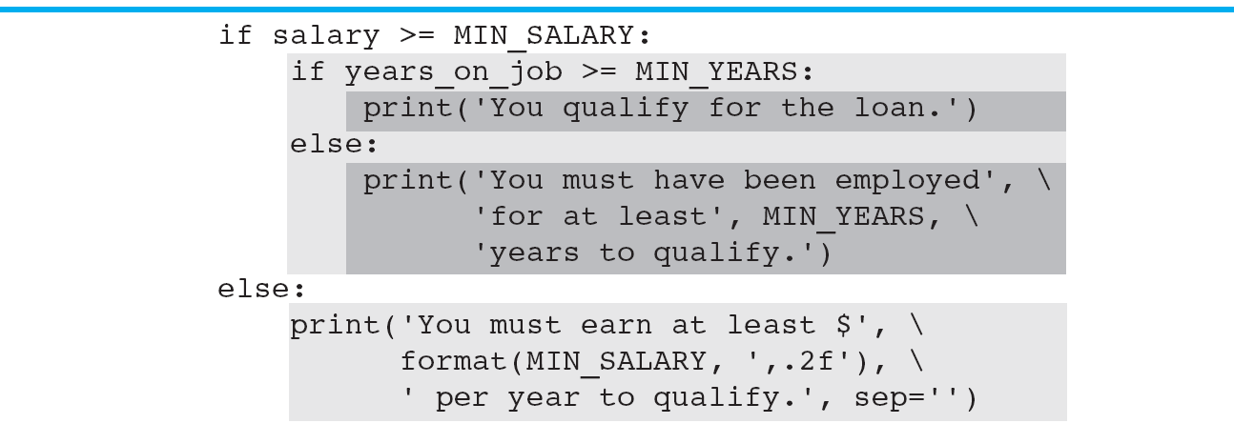
Nested Blocks

Slide 41
Testing a Series of Conditions
Test Score | Grade
90 and above | A
80 – 89 | B
70 – 79 | C
60 – 69 | D
Below 60 | F
Open grader.py

Slide 42
The if-elif-else Statement
Python has a special version of the decision structure which is easier to write – the if-elif-else statement
The general format:
if condition_1:
statement
statement
etc
elif condition_2:
statement
statement
etc
Insert as many elif clauses as necessary
else:
statement
statement
etc

Slide 43
The if-elif-else Statement
Open grader_with_elif.py
Notice alignment – the if, elif, and else are all aligned
if-elif-else is never required because it could be done with nested if-else statements
But – a long series of if-else statements has disadvantages:
The code can grow complex and become difficult to understand
Because of the required indentation a long if-else series can become too wide to be displayed on the computer screen

Slide 44
Chapter 3 In-Class Assignment Part 2
In IDLE – do the following, print and turn in when you are done:
Write a program that asks the user for a number in the range of 1-7. The program should display the corresponding day of the week, where 1 = Monday, 2 = Tuesday, 3 = Wednesday, etc.
If the user enters anything except the numbers 1-7, an error message should be displayed.
Write two programs: one that uses if-else-if logic and the second uses if-elif-else

